Slide 1
SQIL: Imitation Learning via Reinforcement Learning with Sparse Rewards
Literature review

Slide 2
Contents
1
Motivation
2
Methodology

Slide 3
1 Motivation
Multi-agent
Notes:
environment is non-stationary in view of each individual agent = in a way that is not explainable by changes in the agent’s own policy

Slide 4
1 Motivation
Multi-agent
Cooperation
Notes:
environment is non-stationary in view of each individual agent = in a way that is not explainable by changes in the agent’s own policy

Slide 5
1 Motivation
Multi-agent
Cooperation
Communication ?
Notes:
environment is non-stationary in view of each individual agent = in a way that is not explainable by changes in the agent’s own policy

Slide 6
2 Methodology
Given J agents

Slide 7
2 Methodology
Agents cooperate to achieve one goal
(i.e., each agent receives reward signal independent of their contribution)

Slide 8
2 Methodology
Learn the transmission signal for communication

Slide 9
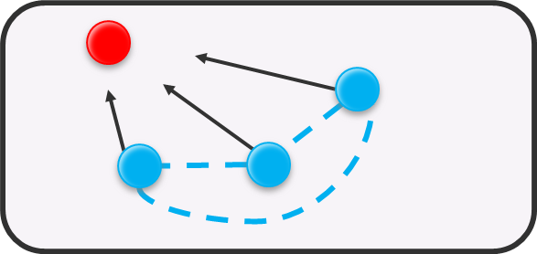
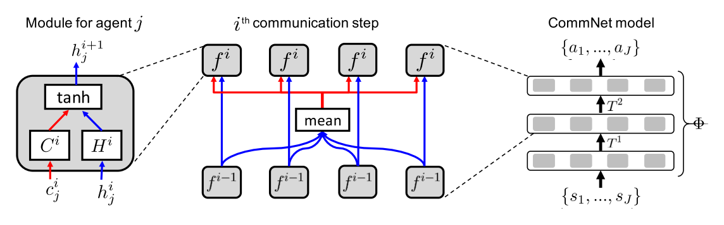
2 Methodology
CommNet model

Slide 10
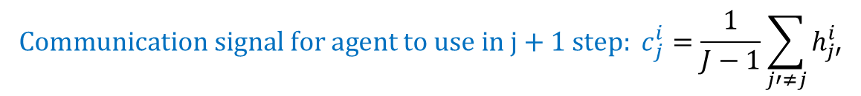
2 Methodology
Model the state with communication scheme
$$Actual state for agent j in i+1 step: h_{j}^{i+1}=tanh⁡(H^{i}h_{j}^{i}+C^{i}c_{j}^{i})$$
$${Communication signal for agent to use in j+1 step: c}_{j}^{i}=\frac{1}{J−1}\sum_{j′≠j}{h_{j′}^{i}}$$

Slide 11
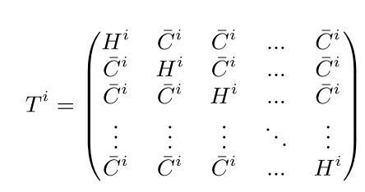

2 Methodology
Generalize the communication with multiple steps and formulate it in vector form:
$$h^{i+1}=tanh⁡(T^{i}h^{i} )$$

Slide 12
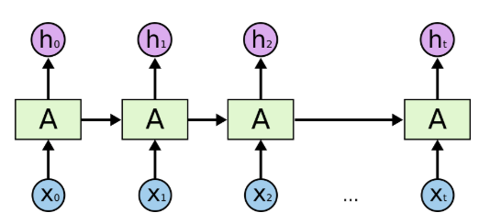
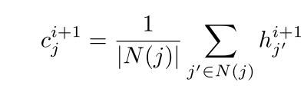
2 Methodology
Extension:
Determine the communication zone
Model the communication step in RNN

Slide 13
Thank you for attention !

